Slide 1
The aim of this document is to perform a capacity analysis of the second-layer capacity system (servers) and forecast their utilization.
Content
Two-layer distributed capacity system description.
Dynamics of the two-layer distributed capacity system busy hours.
Traffic forecast.
Utilization levels of the second-layer capacity.
Brief description of design limitations and balancing model.
Future utilization levels based on the balancing model.
Capacity requirements to maintain 85% utilization across the second-layer capacity.

Slide 2
Brief Description Of The System
A Two-Layered Distributed Capacity System:
First Layer: Geographically distributed channels across Australia with different busy hours for each one. This layer provides access capacity to the network.
Second Layer: Backend traffic acceleration servers to which channels from the first layer are assigned.
The next slide will visually illustrate the architecture...

Slide 3
Two-layered Distributed Capacity Hierarchy
Aggregation Router
High-capacity aggregation router
Server 1
Server 3
Second layer- Backend acceleration servers
Server 100
Each server has a 1 Gbps throughput capacity
Server 2
……………
Channel capacity varies, majority between 100-200Mbps
First layer-Customer’s serving channels
Channel 3
Channel 6
Channel 1
…………………
Channel # 600
Channel 2
Channel 4
Channel 5
Channels are logically grouped by geographical area.

Slide 4
Dynamics of Traffic Busy Hour
Understanding busy hour on a distributed access capacity

Slide 5
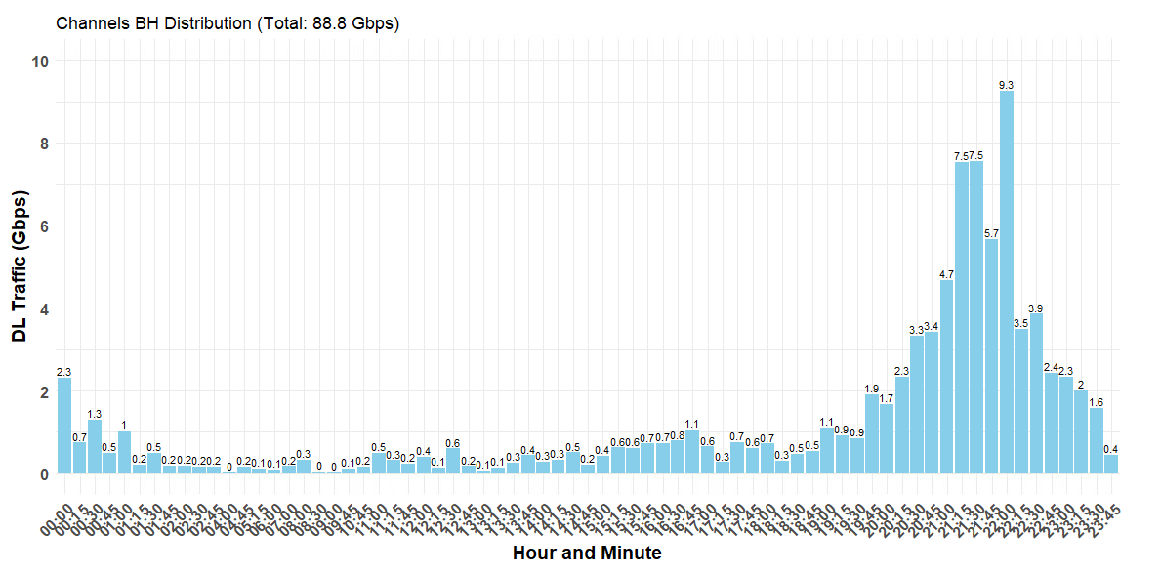
First Access Layer: Channels Busy Hours Distribution.
To assess utilization on the first layer, capturing daily peak utilization of channels will not adequately reflect traffic and workload seasonality. However, capturing weekly peak utilization is considered sufficient for this specific system. For systems with more sensitive workloads, a monthly capture of peak utilization—or more—may be required to better account for seasonality signals.
Although the network busy hour reaches 66 Gbps, aggregating the distributed peaks over a week for each channel sums up to 88.8 Gbps.
All traffic peaks are recorded in AEST.
The above figure captures the weekly maximum peak for each channel. The x-axis represents timestamps, each spaced 15 minutes apart, while the y-axis represents downlink traffic in Gbps.

Slide 6
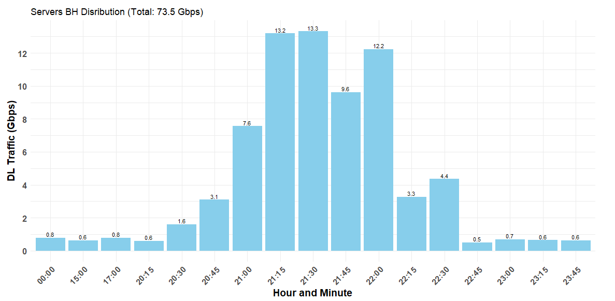
Second Access Layer: Servers Busy Hours Distribution.
A similar trend is observed as in the previous slide. However, in this case, the busy hour distribution is narrower due to the aggregation of first-layer access channels into higher-capacity nodes.
A weekly capture of server busy hours shows a total of 73.5 Gbps, which is lower compared to the first access layer.
The above figure captures the weekly maximum peak for each channel. The x-axis represents timestamps, spaced 15 minutes apart, while the y-axis represents downlink traffic in Gbps.

Slide 7
Traffic Forecast

Slide 8

Traffic Forecast
Traffic Forecast = Historical normalized user’s demand X Customers Count X…
Other factors, such as large account demand, can also be included.
Organic user’s demand
$$=\frac{Network Peak DL Traffic}{Customer count}$$
Normalizing users’ demand separates consumption patterns from customer base growth or decline.

Slide 9
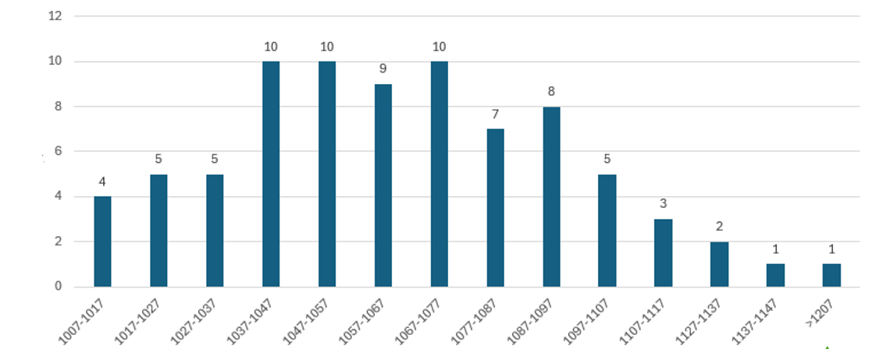
Organic users’ demand input – Actual distribution from Aug to Nov 2024
Days count
Demand per customer (Kbps)
One day, we reached approximately 1200 kbps per customer. I will use this value for the next forecast.

Slide 10
In the next slide, I will incorporate the above demand value into the forecasted customer count for October 2025 and 2026 (with October 2024 as the baseline).
Different scenarios can be created to select the demand value that is considered optimal for the business.
NOTE: The customer base includes two types:
The first type has variable demand (as shown in the previous slide) and influences total traffic.
The second type has a fixed demand of 250 kbps per customer.

Slide 11
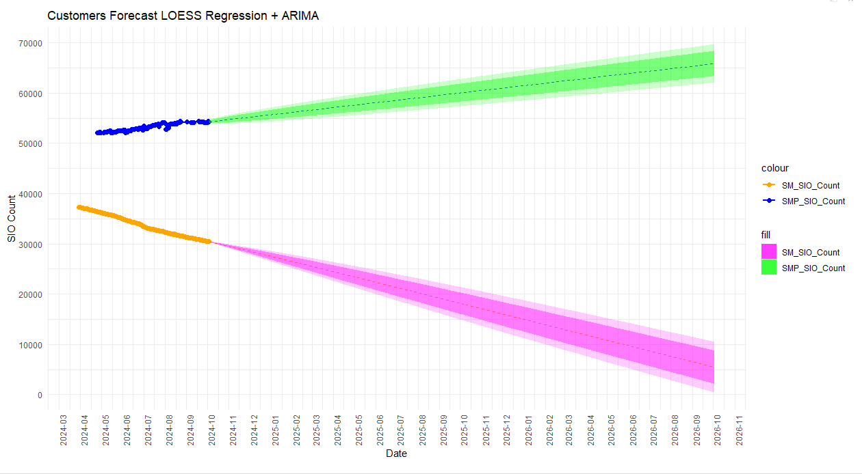
2 Years forecast (downlink traffic)
Oct 2025 Target Agg traffic: 76 Gbps (+10Gbps @ customer demand: 1200bps/250Kbps)
Oct 2026 Target Agg DL traffic:
83 Gbps (+17Gbps @ customer demand: 1200bps/250Kbps)
Current Agg. traffic: ~66Gbps @1100/250 kbps
69 K type 1 customers @ 1200 Kbps
type 1 customers' base trend
LOESS regression is part of stl() function in R to break downtime series components.
ARIMA model is used to extrapolate future values.
Trend
Forecast
type 2 customers' base trend
Zero K type 2 customers @ 250 Kbps

Slide 12
In the next slide, I will illustrate the current utilization levels of the server farm (the second capacity layer).
Then, I will forecast their utilization for 2025 and 2026 to analyze utilization and capacity needs.

Slide 13
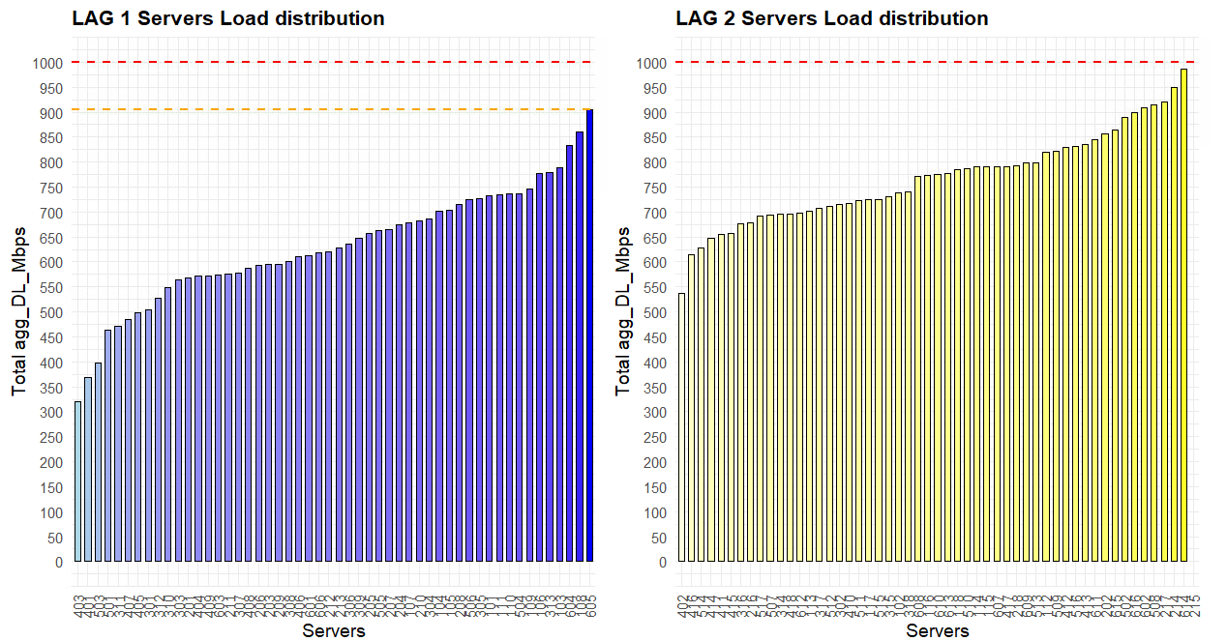
Servers Current Utilization Level
As I mentioned earlier, this system has 100 servers (each with a capacity of 1 Gbps or 100 Mbps), and they are logically separated into two groups: LAG1 and LAG2.
The charts below show the current imbalance in utilization.

Slide 14
Design Limitations:
Access channels in the first layer can only be migrated across servers in pairs, and these pairs are assigned to a specific subsystem.
In some cases, standalone channels exist, which can be moved individually.
Based on the "Least Load Balancing" model, the channel pair with the highest traffic is assigned to server 1, the next highest to server 2, and so on, until server 50 in each LAG. After that, the next "pair/standalone channel" is assigned to the least-loaded server.
This model will be used to balance the servers and forecast their utilization.

Slide 15
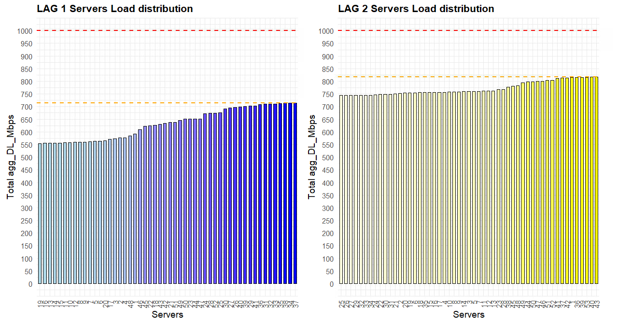
Load balancing at current traffic level
~170 Mbps
~280 Mbps

Slide 16
Applying the forecasted traffic to the servers, the traffic increase is first applied to the access channels, capped by their individual utilization levels, and then aggregated for each serving server.

Slide 17
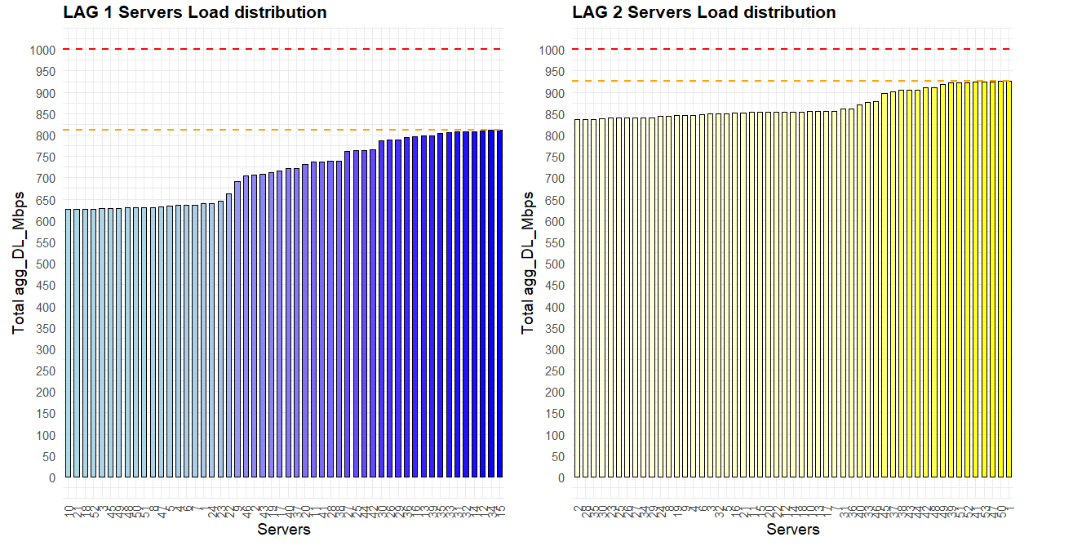
At 76 Gbps –2025
High utilization in LAG2 servers, must be below 85%
~70 Mbps
~190 Mbps

Slide 18
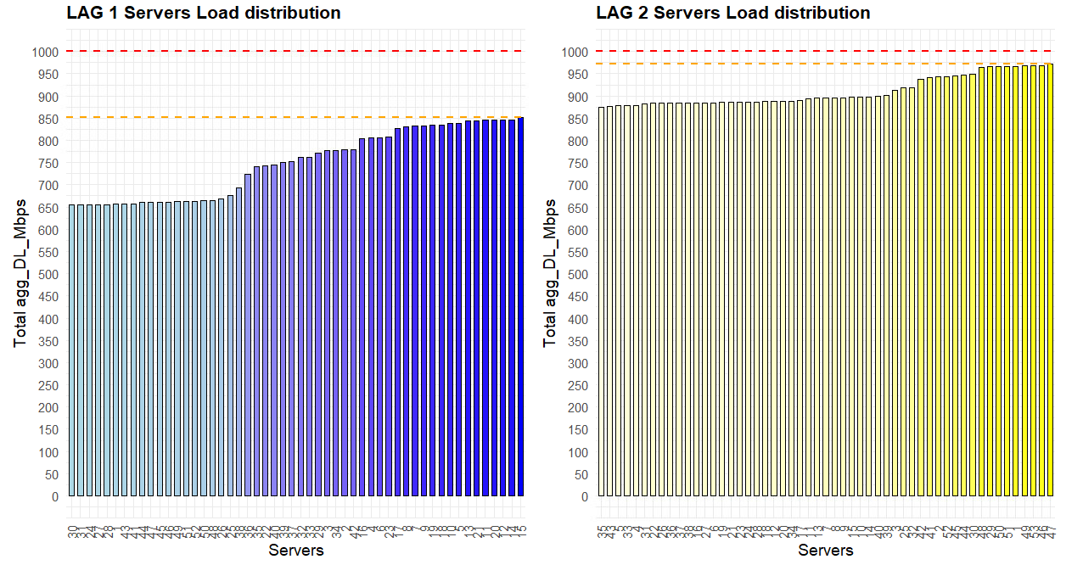
At 83 Gbps –2026
High utilization in LAG2 servers, must be below 85%
~25 Mbps
~150 Mbps

Slide 19
Capacity requirement to maintain <85% utilization

Slide 20
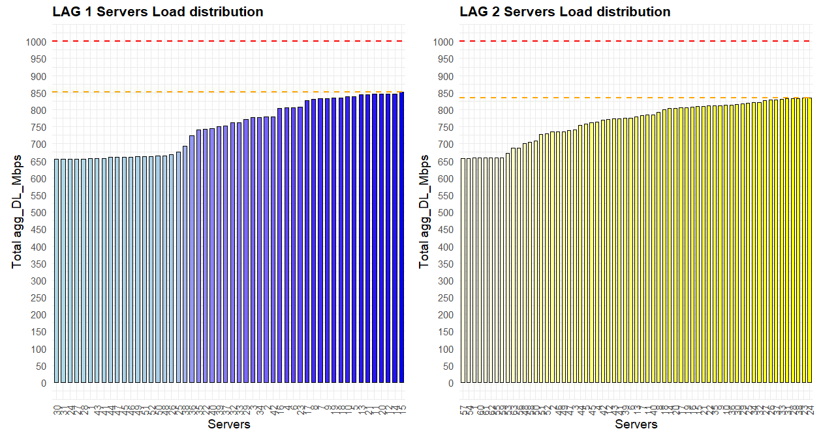
At 83 Gbps 2026 - (add 10 servers to LAG2)
Servers in both LAGs are below 85% utilization in 2026
~150 Mbps
~150 Mbps

